Slide 1
GHADA BADRAN
MRCOG tutor
MRCOG Part 2 course
july 2021 exam
2\ 07 \2021
https://www.drghadabadran.com
MRCOG PART 2 ghada badran group
MRCOG PART 2 ghada badran group
ghada badran youtube channel

Slide 2
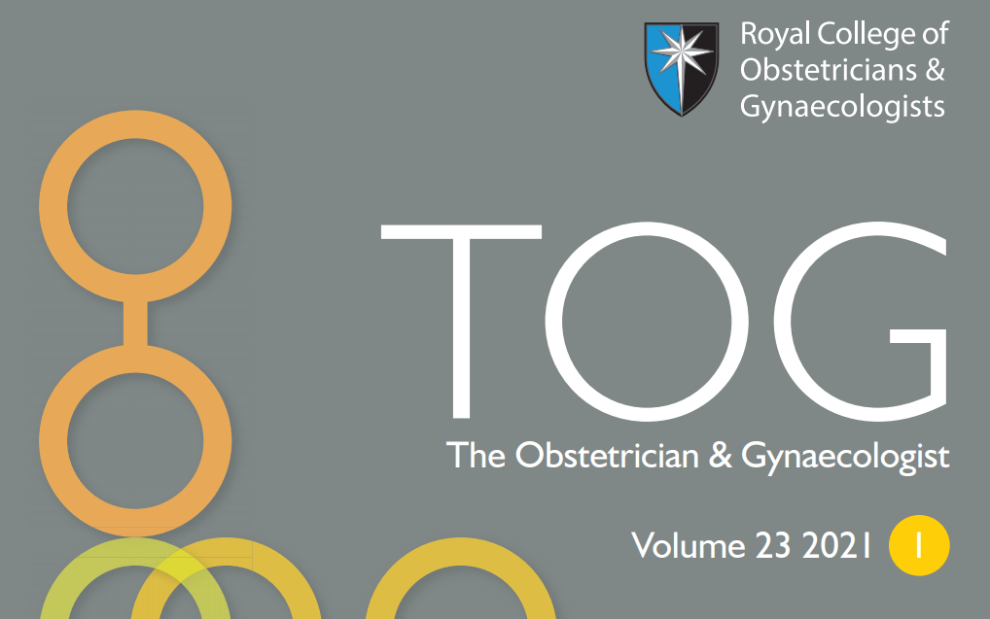

Slide 3
Lynch syndrome for the gynaecologist

Slide 4
Lynch syndrome is an autosomal dominant condition
increased risk of both endometrial and ovarian cancer.
Gynaecological cancer is often the first cancer diagnosis in women with Lynch syndrome.
Colorectal cancer is the most common and lethal cancer seen in Lynch syndrome carriers.
Early diagnosis allows women to be enrolled in cancer surveillance programmes and enables cascade testing for their at-risk family members.
There is a well-documented survival advantage for those with Lynch syndrome who are compliant with colonoscopic surveillance for bowel polyps.
In addition, early identification of Lynch syndrome can enable the uptake of cancer risk-reducing strategies, including taking aspirin and lifestyle modification.
The gynaecologist, therefore, has a crucial role in diagnosing Lynch syndrome and advising women of its implications
Germline sequencing is the definitive test for Lynch syndrome and must always be preceded by informed consent taken by a trained individual.
Up to 95% of Lynch syndrome carriers are unaware.
Lynch syndrome may occur in up to people 1 in 278 making it the most common inherited cause of cancer.
Lynch syndrome arises from inherited mutations, in the genes encoding the proteins of the highly conserved DNA mismatch repair (MMR) system
repair,known as pathogenic variants, affecting MLH1, MSH2, MSH6 and PMS2, the MMR genes responsible for ensuring fidelity
during DNA replication.
Less commonly, inherited inactivation of the MMR system can arise from germline hypermethylation of the promoter region of MLH1

Slide 5
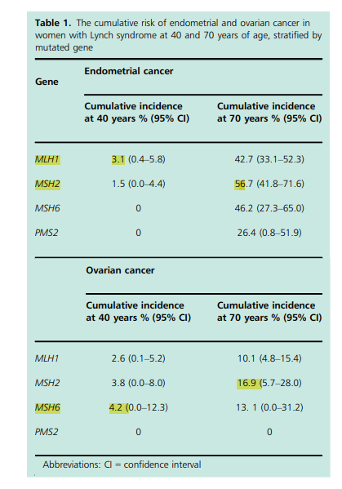
Cumulative lifetime risks of cancer in Lynch syndrome
Ovarian Up to 17%
Endometrial Up to 57%
Colorectal Up to 47%.

Slide 6
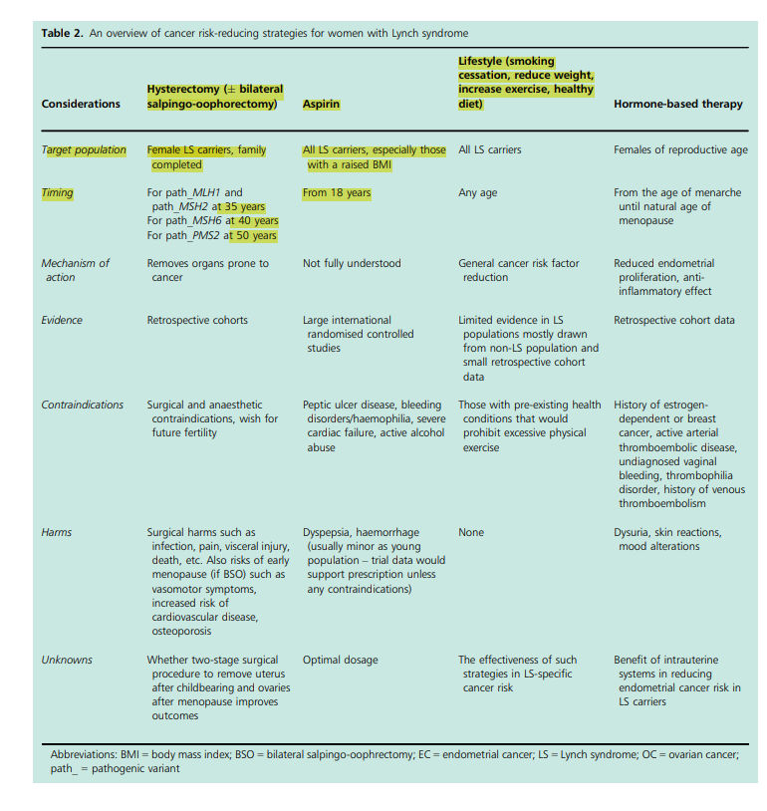

Slide 7
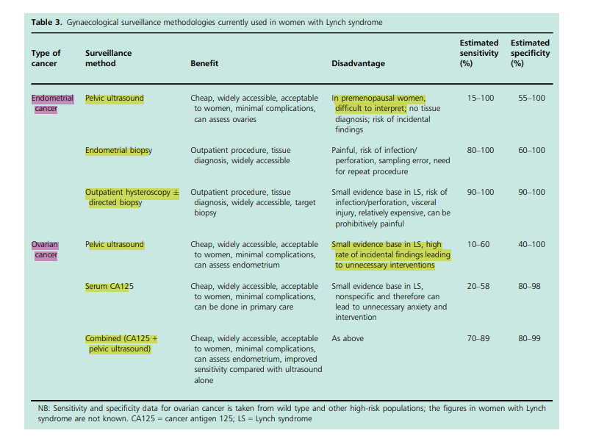
Not all women with Lynch syndrome wish to undergo riskreducing gynaecological surgery; indeed, fertility-sparing options are required for those who wish to pursue motherhood.
Gynaecological surveillance aims to reassure women or detect cancer at a precancerous or early stage to improve morbidity and survival outcomes.

Slide 8
The prevalence of Lynch syndrome in women with endometrial and ovarian cancer is around 3% and 1–2%,respectively.
There is an emerging consensus that all women with endometrial cancer should be screened for Lynch syndrome, where resources permit.
NICE recommends. Where resources are limited,testing can be restricted to those who develop endometrial cancer under the age of 70 years, or where other clinical features are suggestive of Lynch syndrome; for example, a strong family history of Lynch syndrome-associated cancers.
Ideally, women with Lynch syndrome should be seen at around the age of 25 years by an expert gynaecologist to learn about the red ﬂag symptoms of cancer, discuss family planning and explore risk-reducing strategies.
Raising awareness about red ﬂag symptoms empowers women to seek help appropriately.
The survival benefit achieved by risk-reducing surgery is minimal because Lynch syndrome-associated endometrial and ovarian cancers have a good prognosis. However, for many women with Lynch syndrome, avoiding a cancer diagnosis and the harms associated with its treatment is sufficient to choose risk-reducing surgery.
Preoperative counselling by both a clinical geneticist and gynaecologist is seen as best practice.
The laparoscopic approach is preferred because it leads to a shorter recovery time and improved short-term quality of life.
where possible, hysterectomy should be coordinated with other riskreducing interventions, such as colonoscopy or colorectal surgery. Hysterectomy and bilateral salpingo-oophorectomy at 40 years of age has been shown to be a costeffective strategy.
The lifetime risk of gynaecological cancer is sufﬁciently high to offer total hysterectomy and bilateral salpingo-oophorectomy for women with Lynch syndrome who have completed childbearing

Slide 9
Risk-reducing strategies
Hysterectomy
The lifetime risk of gynaecological cancer is sufficiently high to offer total hysterectomy +/-
bilateral salpingo-oophorectomy for women with Lynch syndrome who have completed childbearing.
The timing of such surgery is gene-specific .
Preoperative counselling by both a clinical geneticist and gynaecologist is seen as best practice.
The laparoscopic approach is preferred because it leads to a shorter recovery time .
Aspirin has been shown to reduce the risk of cancer in Lynch syndrome.
The oral contraceptive pill reduces the risk of sporadic ovarian and endometrial cancer,
and the levonorgestrel-releasing intrauterine system reduces the risk of endometrial cancer in the general population, so it is thought these may also reduce cancer risk in Lynch syndrome.
While few studies have specifically explored the effect of lifestyle choices on cancer risk in Lynch syndrome, smoking cessation, maintaining a healthy body mass index and increased exercise are thought sensible Gynaecological surveillance There is currently no strong evidence to support gynaecological surveillance for the early detection of gynaecological cancer in Lynch syndrome.

Slide 10
Tumour-based testing Germline testing
Tumour-based testing does not identify people with Lynch syndrome; it stratifies their risk for the condition.
This is important because it is widely accepted that tumour-based tests can be done without explicit consent.
They are used to identify individuals who should undergo definitive,
Immunohistochemistry tests for loss of MMR protein expression (MMR deficiency).
There is a relative lack of specificity, associated with somatic loss of MMR expression.
Microsatellites are repeated DNA motifs. If microsatellite instability is high, Lynch syndrome is more likely.
germline testing is the only way in which a Lynch syndrome diagnosis can be made.
It is expensive and can only be done in specialist centres.
These tumours are very immunogenic, eliciting a marked and unique immune response .
The main mechanism of immune evasion seen in MMR-deﬁcient cancers is exploitation of the PD-1/PD-L1 pathway.
Novel strategies are being tested to harness the Lynch syndrome patient’s own immune system to prevent cancers through vaccination.
Novel diagnostic methods, with the potential for complete automation, are in development.
Such technologies would simplify and reduce the costs of Lynch syndrome screening and diagnostic pathways.

Slide 11
SBA 1
With regard to Lynch syndrome, which of the following is false
A) most carriers of the mutation associated with the syndrome know they have the condition.
B) the first cancers associated with the syndrome are predominantly endometrial or ovarian cancers.
C) when cancers occur, they have in them an unusually high immune infiltrate.

Slide 12
B) most carriers of the mutation associated with the syndrome know they have the condition.

Slide 13
SBA 2
Which of the following false
A . consent must be sought before definitive germline testing for Lynch syndrome by a trained professional.
B . immunohistochemical staining of tumours for the mismatch repair proteins or microsatellite instability analysis are recognised ways
of screening cancers for characteristics suggestive of the syndrome.
C . the National Institute for Health and Care Excellence endorses universal screening of colorectal cancer patients for Lynch syndrome.
D . most gynaecological cancers found to have aberrant mismatch repair immunohistochemical staining will be in those with
the syndrome.
E . the addition of MLH1 promotor hypermethylation testing in a Lynch syndrome diagnostic pathway improves specificity.

Slide 14
E . the addition of MLH1 promotor hypermethylation testing in a Lynch syndrome diagnostic pathway improves specificity.
Less commonly, inherited inactivation of the MMR system can arise from germline hypermethylation of the promoter region of MLH1

Slide 15
SBA 3
Regarding gynaecological surveillance in women with Lynch syndrome,
which of the following is false
A . there is strong evidence to recommend its use.
B. this should be offered to women around 25 years of age.
C . counselling should include education on red flag symptoms of cancer and risk reducing surgery.

Slide 16
A . there is strong evidence to recommend its use.
Surveillance for gynaecological cancer in women with Lynch
syndrome remains controversial; more robust data are needed to
determine its effectiveness.

Slide 17
SBA 4
With regard to risk-reducing strategies for women with Lynch syndrome,
Which of the following is false
A. hysterectomy is strongly recommended for all those with the syndrome.
B. the timing of risk-reducing surgery depends on the syndrome gene.
C. where possible, a laparoscopic approach is recommended.
D. aspirin is not recommended as a means of reducing their overall cancer risk.

Slide 18
D. aspirin is not recommended as a means of reducing their overall cancer risk.

Slide 19
SBA 5
Regarding Lynch syndrome-associated gynaecological cancers,
Which of the following is false ?
A . endometrial types that arise as a result of the syndrome have a poorer prognosis than sporadic types.
B . checkpoint inhibition of the PD-1/PD-L1 pathway has been shown to be very effective in mismatch repair-deficient cancers.
C. vaccination against these cancers is currently the focus of research.

Slide 20
A . endometrial types that arise as a result of the syndrome have a poorer prognosis than sporadic types.

Slide 21
Raised CA125

Slide 22
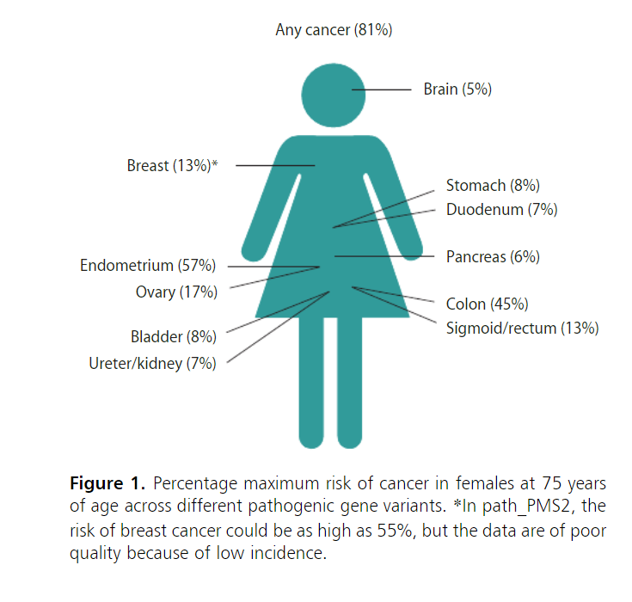
Raised CA125
CA125 may be elevated in many benign and malignant conditions.
a normal level of CA125 is considered to be <35 IU/ml.
Ovarian cancer is the leading cause of death from any gynaecological malignancy.
Over 70% of women diagnosed will present with late stage disease (stage III or IV).
CA125 measurement during follow-up is not mandatory.
Serum CA125 levels are often elevated in ovarian epithelial cancers but
less commonly seen to be in non-epithelial cancers of the ovary.

Slide 23
CA125 screening is used in the diagnosis of symptomatic patients.
no evidence to suggest that screening postmenopausal women with a one-off CA125 serum blood test will reduce patient mortality.
because 50% of women with stage I disease, and those with occult cancers identified at prophylactic surgery, have normal levels
of this tumour marker. (The sensitivity and specificity of CA125 assay is known to be poor. )
CA125 levels are elevated in only 75–90% of patients with advanced disease.
malignancy index (RMI) for patients presenting with ovarian cysts.
A level of over 250 IU/ml should trigger referral to a cancer centre for subsequent management.
Traditionally, assays for carbohydrate antigen 19-9 (CA19-9) and carcinoembryonic antigen (CEA)
have been used in the screening criteria for gynaecological pelvic malignancies and may be
beneficial for patients in whom no obvious cause of a raised CA125 level is found.
Serial monitoring of CA125 levels is advantageous in such patients.
because it has been observed that levels appear to rise progressively over time in patients with malignancy.

Slide 24
CA125 levels have been shown to be elevated in various benign conditions, including
benign ovarian cysts
tubo-ovarian abscess
Endometriosis
pelvic inflammatory disease
fibroids
ovarian hyperstimulation syndrome.
if women is that a serum CA125 level is crucial if any cystic lesion of more than 1 cm in diameter is identified on the ovary.
Levels of CA125 in the ascitic fluid do correlate with the serum levels, but are much higher than those seen in the blood.
This indicates that the antigen originates in the ascitic fluid, rather than in the tumour itself.
For patients with symptoms of ovarian cancer, current national guidance recommends CA125
testing as an initial investigation.1 CA125 level is also required to calculate a risk

Slide 25
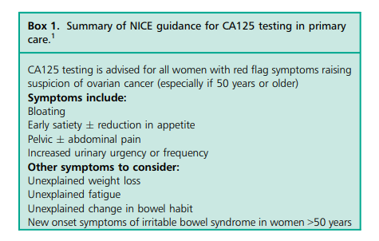
the diagnosis of ovarian cancer, a CA125 test is often used in conjunction with transvaginal ultrasound scanning (TVUSS).
there is little evidence that this approach can reduce mortality from ovarian cancer, partly because 50% of women with stage I disease, and those with occult cancers identified at prophylactic surgery, have normal levels of this tumour marker.

Slide 26
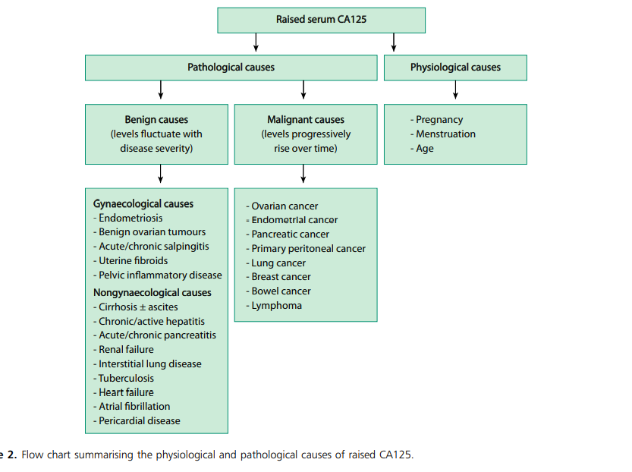

Slide 27
SBA 6
Carbohydrate antigen 125 (CA125) is true
A. elevated when the serum level is above 40 U/ml.
B . expressed in tissues derived from embryonic coelomic tissue.
C . a mandatory test in follow-up of patients with ovarian cancer.
D . a reliable screening biomarker.

Slide 28
B . expressed in tissues derived from embryonic coelomic tissue.

Slide 29
SBA 7
Which of the following is false ?
A. elevated in over 70% of women with advanced ovarian cancer.
B. only elevated in ovarian epithelial cancers.
C. normal in 50% of women with stage I ovarian cancer.

Slide 30
B. only elevated in ovarian epithelial cancers.

Slide 31
SBA 8
With regard to ovarian cancer, which of the following is true ?
A. it is the leading cause of death from any gynaecological malignancy.
B. approximately 70% of women present in stage I–II.
C. a risk of malignancy index of over 300 only is a trigger for patient referral to a cancer centre.

Slide 32
A. it is the leading cause of death from any gynaecological malignancy.

Slide 33
SBA 9
With regard to current guidance on the diagnosis of ovarian cancer, which of the following false
A . pelvic ultrasound scan is considered the first line investigation for women presenting with symptoms of ovarian cancer.
B . CA125 testing should be done in all postmenopausal women with a cystic lesion of 1 cm or more on the ovary.
C. age-specific CA125 cut-offs are less accurate and increase false-positive results.

Slide 34
C. age-specific CA125 cut-offs are less accurate and
increase false-positive results.

Slide 35
SBA 10
With regard to CA125 in ascitic fluid, which of the following is false ?
A . levels correlate with those in the serum.
B. it is produced by tumour cells.
C . levels are higher than those in blood.

Slide 36
B. it is produced by tumour cells.

Slide 37
SBA 11
With regard to the use of CA125 in the screening of ovarian cancer,
Which of the following is false
B) guidelines recommend it as part of initial investigation.
C) a one-off serum blood test has been shown to reduce patient mortality.
D) CA125 levels correlate positively with ascitic volume.

Slide 38
C) a one-off serum blood test has been shown to reduce patient mortality.

Slide 39
Does ovarian cystectomy pose a risk to
ovarian reserve and fertility?

Slide 40
Functional ovarian cysts have been described as non pathological follicular cysts that failed to ovulate, a
persistent corpus luteum cyst, or other unspecified ovarian cysts measuring more than 20 mm in diameter.
They are the most common ovarian cysts in adults and children and account for 46–53% of all adnexal
pathologies regress spontaneously within one to three menstrual cycles,
so should not require any interventions.
With the exception of luteal cysts and persistent functional cysts, functional ovarian cysts.
Luteal cysts are observed in 10% of natural menstrual cycles in fertile women.
luteal cysts occurred in 25% of intrauterine insemination (IUI) cycles in women with unexplained infertility.

Slide 41
Dermoid cysts and their effects on fertility
A dermoid cyst is a benign type of germ cell tumour arising from totipotent ovarian cells.
They are the most common pathological cysts in premenopausal women.
They are bilateral in 10–20% of cases .
The recurrence rate following cystectomy is 3–4%.
the effects of dermoid cysts on ovarian function and fertility, and none have shown a negative effect.
the antimullerian hormone (AMH) levels in women with unilateral and bilateral dermoid cysts with those of controls and found no significant difference.
the ovarian cortex seemed to be stretched but not damaged by the dermoid cyst.
the ovarian cortical tissue surrounding benign cysts removed at cystectomy.
The cortical tissue surrounding dermoid cysts showed normal morphological patterns and a regular vascular network similar to that of the normal ovarian cortex.
One study showed a statistically significant reduction in AMH following surgery for cysts over 5 cm in diameter.Therefore, operating early, while the cyst is still small, may prevent the need for a large cystectomy and thus lower the effect on the ovarian reserve.

Slide 42
Endometriomas, or ovarian endometriotic cysts, are reported in 17–44% of women with endometriosis and are a marker of more severe, deeper disease.
Furthermore, 28% of endometriomas are bilateral.
With regard to effects on ovarian reserve, two prospective studies demonstrated lower AMH levels and antral follicle counts (AFC) in women with endometriomas compared with age-matched controls.
Endometriomas were also thought to negatively affect ovulation, one study showing lower ovulation rates in ovaries containing endometriomas greater than 10 mm in diameter compared with the healthy contralateral ovary.
more recently, Maggiore and colleagues conducted a larger prospective study all of whom had a unilateral endometrioma greater than 20mm in diameter, and performed ultrasound monitoring for ovulation over six cycles. No difference was found in the ovulation rates between the affected ovary and healthy ovary

Slide 43
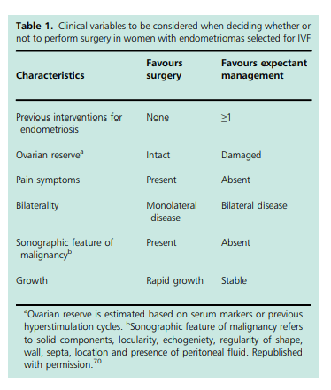
Cystectomy for endometriomas prior to IVF treatment is not routinely recommended because it has not been shown to improve IVF outcomes.
A Cochrane review assessed the effectiveness of surgery versus no treatment for women with an endometrioma prior to undergoing assisted reproductive technology (ART).
Apart from cyst excision, several other surgical techniques exist, including drainage and bipolar coagulation or ablation using plasma or laser energy.
cystectomy to be superior to drainage and bipolar coagulation in terms of spontaneous pregnancy rates, lower risk of recurrence and pain symptoms among subfertile patients with endometriomas greater than 3 cm in diameter. Incision should be away from the blood vessels in the hilum/mesovarium.
Use of cold cut at the edge of the cyst opening may assist in identifying the cleavage plane.

Slide 44
Teratomas constitute about half of all ovarian neoplasms in children and 1% of these are malignant immature teratomas.
Since laparoscopic cystectomy has become the accepted practice for the management of mature cystic teratomas in adults, the same approach should apply to children and adolescents.
With greater use of preoperative investigations, including pelvic imaging and tumour markers, along with a multidisciplinary team approach and conservative surgery, we should be able to better protect the future fertility of these young girls.
Malignant ovarian cysts are uncommon in children and adolescents.
Despite this, oophorectomy is frequently performed in this age group.
One study found that 75% of oophorectomies in children and adolescents had been carried out for benign ovarian cysts.
Functional ovarian cysts account for about 45% of all paediatric adnexal abnormalities and usually resolve spontaneousl.
Ovarian torsion and its effect on fertility Ovarian torsion is a rare gynaecological emergency.
Approximately 3% of all emergency gynaecological surgeries are for ovarian torsion.

Slide 45
Conservative management, which involves laparoscopic unwinding of the twisted ovary, is the treatment of choice in prepubescent girls and women of reproductive age, regardless of the colour of the ovary at the time of surgery.
When an ovary undergoes torsion and detorsion, it results in haemorrhage, congestion and apoptosis secondary to ischaemia, which can affect the ovarian reserve.
One retrospective study found that detorsion of the ischaemic ovary preserved ovarian function in 91.3% of patients; this was demonstrated by follicular development on ultrasound, normal ovary at subsequent laparotomy for other indications and successful fertilisation of oocytes retrieved from the ischaemic ovary following controlled ovarian stimulation.
compared with oophorectomy, laparoscopic detorsion has the potential to preserve the ovarian reserve and should remain the optimal treatment in girls and premenopausal women.
In cases where torsion has occurred in the presence of an ovarian cyst, an elective cystectomy 2–3 weeks later is advised to allow time for the congestion and oedema to resolve.

Slide 46
Several other studies have also demonstrated a reduction in the ovarian reserve following cystectomy for endometriomas.
There is also a higher risk of oophorectomy when performing large cystectomies.
Clinicians frequently advise patients to delay surgery until a cyst reaches a particular size, when there is a significant risk of ovarian torsion.
It may be wiser to proceed with surgery when the cyst is small; especially in those with mucinous cystadenomas, which have a propensity to grow into large cysts.
Bilateral cystectomy can also lead to a greater decline in the ovarian reserve than with unilateral surgery.
women having surgery for bilateral endometriomas have been shown to have an increased risk of developing
premature ovarian insufficiency.

Slide 47
SBA 12
With regard to functional ovarian cysts, which of the following is incorrect?
A) they are the most frequently occurring cysts in adults and children.
B) luteal cysts are observed in 25% of natural menstrual cycles in fertile women.
C) women with low ovarian reserve are at increased risk of developing them.
D) luteal cysts result from unruptured follicles.
E) they almost always regress spontaneously within one to three menstrual cycles.

Slide 48
B) luteal cysts are observed in 25% of natural menstrual cycles in fertile women.

Slide 49
SBA 13
With regard to dermoid cysts, which of the following is false
A) they are bilateral in 30–40% of cases.
B) they are associated with a reduction in ovarian reserve.
C) All is false

Slide 50
C) All is false

Slide 51
SBA 14
With regard to endometriomas, which of the following is true
A ) women with endometriomas have lower ovarian reserve (as measured by antimullerian hormone and antral follicle counts) compared with age matched controls.
B) cystectomy prior to in vitro fertilisation treatment has been shown to improve outcomes.
C) recurrence rates are similar following either cystectomy or drainage and diathermy

Slide 52
A . women with endometriomas have lower ovarian reserve
(as measured by antimullerian hormone and antral follicle counts) compared with age matched controls.

Slide 53
SBA 15
With regard to benign ovarian cysts in children and adolescents,which of the following is true
A. malignant teratomas account for about 1% of all teratomas in children.
B. functional ovarian cysts account for about one-third of all paediatric adnexal masses.

Slide 54
A. malignant teratomas account for about 1% of all teratomas in children.

Slide 55
SBA 16
With regard to ovarian torsion, which of the following is false
A. it accounts for approximately 3% of all emergency gynaecological surgery.
B. laparoscopic detorsion appears to preserve ovarian function
C. untwisting at the time of surgery should be followed by cystectomy if circulation returns.

Slide 56
C. untwisting at the time of surgery should be followed by cystectomy if circulation returns.

Slide 57
SBA 17
With regard to ovarian reserve assessments,
which of the following is incorrect?
A) ovarian cystectomy has been associated with a reduction in the ovarian reserve.
B) they are recommended before ovarian cystectomy in women who have severe endometriosis and bilateral endometrioma.
C)In case of ovarian cystectomy the initial incision on the cyst should be made close to the mesovarium.
D) In case of ovarian cystectomy gonadotrophin-releasing hormone agonist therapy is used for large endometriomas to reduce the thickness of the cyst wall.

Slide 58
C)In case of ovarian cystectomy the initial incision on the cyst
should be made close to the mesovarium.

Slide 59
Very advanced maternal age

Slide 60
very advanced maternal age’
(vAMA) to refer to women who are aged 45 years or more at the time of delivery
Spontaneous conception in women of vAMA is rare, but more common in parous women.
Conception using autologous embryos is also rare;
the live birth rate is 2.9% in a cycle for women aged 45 years.
the live birth rate was so low, it was reported as being 0%,for women aged 46 years and older,
women of vAMA, focusing on women aged 48 years and over,
It showed that 78% of the women delivering had conceived using ART.
Of these, 51% had assisted conception performed outside the UK,
91% reported using egg donation and 21% had used donor sperm.
Of these women, 40% had one embryo transferred, 45% had two embryos transferred and 15% had three or more embryos transferred. Just under half of those who had multiple embryos transferred went on to have a multiple pregnancy.

Slide 61
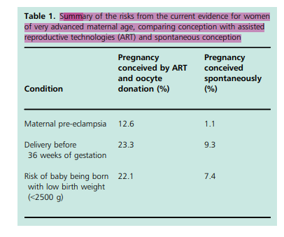
.Pre-eclampsia complicates just 1.1% of natural conception pregnancies and
12.6% of oocyte donation conceptions in women of vAMA.
Women of vAMA who become pregnant as a consequence of ART should, like all women, have a risk assessment at booking; they should be offered low-dose aspirin (150 mg) from 12 weeks of gestation until delivery.
SGA. Miscarriage rates increase with increasing maternal age. In women of vAMA, the overall risk of miscarriage is 53%

Slide 62
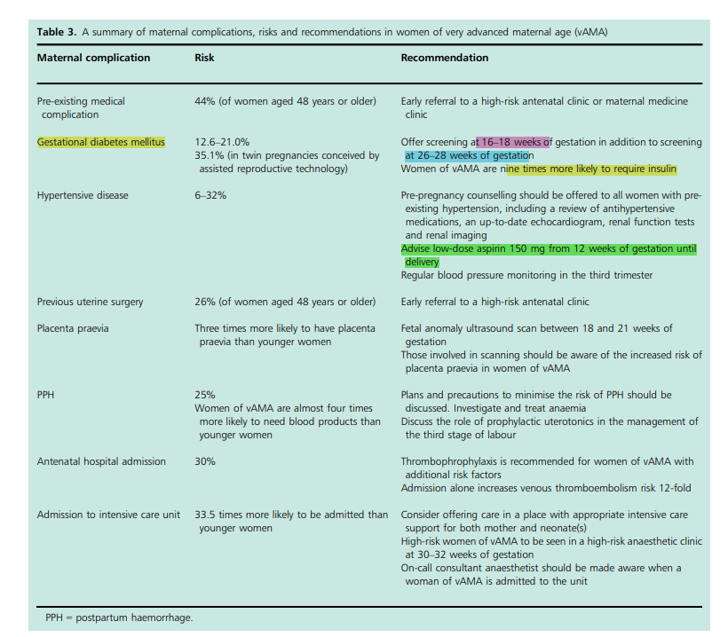

Slide 63
The risk of an ectopic pregnancy in women with vAMA is three times the overall risk of ectopic pregnancy in all women.
Clinicians should be aware there is some evidence that women aged 40 years and older with ectopic pregnancies are twice as likely to need a blood transfusion than younger women.
A VTE reassessment after miscarriage or ectopic pregnancy should be performed, following findings from the most recent confidential enquiry into maternal deaths in the UK.
women of vAMA have consistently recorded the highest multiple pregnancy rate, secondary to increasing availability of ART and the number of embryos transferred.
women of vAMA in the UK had a multiple pregnancy rate of 79.3/1000 compared with
15.4/1000 in all women.

Slide 64
Women of vAMA are nine times more likely to require insulin to treat GDM than younger women.
Pre-eclampsia, severe or early onset pre-eclampsia and eclampsia are more common in women of vAMA than in younger women.
Fitzpatrick et al.3 found that 6% of women aged 48 years and older developed pre-eclampsia or eclampsia
compared with 2% of younger women.
Meyer24 found that 32% of vAMA with multiple pregnancy conceived by ART developed pre-eclampsia or eclampsia compared
with 6.2% of younger women who conceived a twin pregnancy by ART.
Despite these figures, most maternal outcomes are good and there is some evidence that women of vAMA are not at greater risk of complications from hypertension solely based on their age.
When pre-existing maternal health is documented, it seems that the main predictor of outcomes is maternal health and not maternal age.
Pre-pregnancy counselling should be offered to all women with pre-existing hypertension, including a review of antihypertensive medications, an up-to-date echocardiogram, renal function tests and renal imaging.

Slide 65
Hypothyroidism is more common in women of vAMA.
Surveillance of thyroid function and treatment with levothyroxine is an effective management strategy.
Venous thromboembolism Evidence that maternal age affects rates of VTE is conflicting: Fitzpatrick et al.3 found that rates of thrombotic events were the same in women across all age groups; however, previous large studies have shown that women over the age of 35 years have a 70% increase in VTE in the postpartum period.
Current guidance in the UK simplifies risk and states that age greater than 35 years is a risk factor for VTE antenatally and postnatally.
Women of vAMA who become pregnant as a consequence of ART should, like all women, have a risk assessment at booking; they should be offered low-dose aspirin (150 mg) from 12 weeks of gestation until delivery.
They should also be assessed for VTE, since women who have conceived with ART are at increased risk, particularly in the first trimester.
The most recent review of maternal deaths in the UK recommends clear pathways for women to access early prescriptions and support for thromboprophylaxis to ensure compliance.
Women of vAMA with multiple pregnancy have increased rates of fetal and maternal complications compared with women of
vAMA with singleton pregnancies and younger women with multiple pregnancies.
Pregnancies in women of vAMA have increased risks of preexisting medical conditions, GDM, gestational hypertension, pre-eclampsia, abnormal placentation, ICU admission, caesarean delivery, postpartum haemorrhage (PPH), blood transfusion and prolonged admission to hospital. They are less likely to smoke cigarettes.
44% of women aged 48 years or older had a reported pre-existing medical condition compared with
28% of younger women.

Slide 66
Women of vAMA are three times more likely to have placenta praevia.
All women should be advised to have a fetal anomaly ultrasound scan between 18 and 21 weeks of gestation and those involved in scanning should be aware of the increased risk of placenta praevia in women of vAMA.
Women of vAMA are three times more likely to have a placental abruption than younger women.
It is difficult to predict and no effective prevention treatments are currently available.
Women of all ages are advised to report all vaginal bleeding to their antenatal care provider.
Placental abruption is a clinical diagnosis and there are no sensitive or reliable diagnostic tests available. Ultrasound has limited sensitivity in the identification of retroplacental haemorrhage.
Obesity Women aged 48 years or more are more likely to be overweight or obese than younger women.3 Pregnant women who are obese are at greater risk of pre-eclampsia,
Admission to hospital and intensive care Women of vAMA have a 30% risk of antenatal hospital admission and are 33.5 times more likely to be admitted to ICU than younger women.

Slide 67
Postpartum haemorrhage PPH has been shown to be the most statistically significant
complication affecting women of vAMA, whether they are primiparous or
multiparous, having a singleton or multiple pregnancy, conceived spontaneously or by ART.
PPH affects one in four women of vAMA.
Women with multiple pregnancies, pre-eclampsia and those receiving thromboprophylaxis are at
particular risk. PPH affects one in four women of vAMA.
Women of vAMA are almost four times more likely to need blood products following a
PPH than younger women.
3 Plans and precautions to minimise the risk of PPH should be discussed with the mother
in the antenatal period, including the investigation and treatment of anaemia and the role of prophylactic
uterotonics in the management of the third stage of labour.
Trisomy and congenital anomalies The risk of Down syndrome (trisomy 21) is directly
related to maternal age if a pregnancy is conceived spontaneously. In donor embryos,
it is related to the age of the donor.

Slide 68
The incidence of trisomy 21 at term is 1:1350 for a 25-year-old woman (or donor).
1:35 at the age of 45 years
1:25 at the age of 49 years.
Using a cut-off of 1 in 150 at term as a screen-positive result, one in four women of vAMA will screen positive.
A screen-positive result requires careful counselling. Invasive diagnostic testing
(amniocentesis or chorionic villous sampling) can be offered;
it gives accurate results but has a small risk of miscarriage.

Slide 69
an ectopic pregnancy in women with vAMA is three times
vAMA are three times more likely to have placenta praevia.
three times more likely to have a placental abruption than younger women.
Pre-eclampsia 3 fold times
Four as likely to need a blood transfusion than younger women post partum.
Women of vAMA are nine times more likely to require insulin to treat GDM than younger women.
Admission to hospital and intensive care Women of vAMA have a 30% risk of antenatal hospital admission and are 33.5 times more likely to be admitted to ICU than younger women.

Slide 70
SBA 18
Pregnancy following conception via assisted reproductive technologies in women of advanced maternal age,
which of the following option is incorrect
A) is significantly more likely to result in a live birth if a donor embryo rather than an autologous embryo is used.
B) is associated with a two-fold increase in the risk of developing pre-eclampsia in comparison to a pregnancy following spontaneous conception.
C) is an indication for aspirin (150 mg) from 12 weeks of gestation until delivery to decrease the risk of pre-eclampsia and small-forgestational age.

Slide 71
B) is associated with a two-fold increase in the risk of
developing pre-eclampsia in comparison to a pregnancy
following spontaneous conception.

Slide 72
SBA 19
With regard to early pregnancy in women of very advanced maternal age,
Which of the following is incorrect?
A. there is an overall 53% risk of miscarriage.
B. the overall risk of ectopic pregnancy in those aged 44 years or more is twice that in younger women.
C. there is evidence that women aged 40 years and above are twice as likely to need a blood transfusion during an admission for an ectopic pregnancy in comparison to younger women.

Slide 73
B. the overall risk of ectopic pregnancy in those aged 44
years or more is twice that in younger women.
3 TIMES

Slide 74
SBA 20
Women of very advanced maternal age are more likely than younger women to be,
A. multiparous.
B. overweight or obese.
C.All is true

Slide 75
C. All is true

Slide 76
SBA 21
Which of the following is false
A) Multiple pregnancy rates in women of very advanced maternal age, have been consistently higher than in any other age group due to multiple embryos being transferred during assisted reproductive technology.
Women with advanced maternal age the most significant risk factor for developing pre-eclampsia is obesity.
C)After ART , Aspirin 75 mg should be started from 12 weeks

Slide 77
C)After ART , Aspirin 75 mg should be started from 12 weeks

Slide 78
SBA 22
Which of the following is false
A) Venous thromboembolism risk in women of very advanced maternal age,
is increased mainly in the first trimester following assisted reproductive technology.
B) advanced maternal age, There are three times more likely to have placenta praevia than younger women.
C) Women of vAMA are three times more likely to have a placental abruption than younger women
D) All true

Slide 79
D) All true

Slide 80
SBA 23
Which of the following is false
A) Regarding postpartum haemorrhage, it complicates one in four pregnancies in women of very advanced maternal age.
B) Regarding postpartum haemorrhage,women of very advanced maternal age are almost twice as likely to need blood
products than younger women.
C. Women of very advanced maternal age, are 33.5 times more likely to be admitted to intensive care than younger women.

Slide 81
B. women of very advanced maternal age are almost twice as likely to need blood products than younger women.
Women of vAMA are almost four times more likely to need blood products following a PPH than younger women.

Slide 82
SBA 24
Regarding trisomy, which of the following is true
A) the risk of having a child with trisomy 21 is 1:35 at the age of 45.
B) if a cut off of 1 in 150 is used as a screen positive result, one in four women of very advanced maternal age will screen positive.
C) All true

Slide 83
C) All true
1:1350 for a 25-year-old woman (or donor).
1:35 at the age of 45 years
1:25 at the age of 49 years.
Using a cut-off of 1 in 150 at term as a screen-positive result, one in four women of vAMA will screen positive.

Slide 84
Care in pregnancies subsequent to stillbirth or perinatal death

Slide 85
stillbirth ‘a baby delivered with no signs of life known to have died after 24 completed weeks of pregnancy.
98 percent of stillbirths occur in low- and middle-income countries (LMICs).
the estimated proportion of intrapartum stillbirths varies from approximately 10% in HICs to 60% in South Asia
this is closely related to access to high-quality antenatal and intrapartum care.
Risk factors
low socioeconomic status
advanced maternal age
essential hypertension
pre-eclampsia
antepartum haemorrhage (APH)
fetal growth restriction (FGR
A history of previous stillbirth is a recognised risk factor for stillbirth in a subsequent pregnancy.
in HICs, demonstrated a stillbirth rate in 2.5% of women with a previous history of stillbirth compared with a
rate of 0.4% when previous pregnancy resulted in a livebirth.

Slide 86
study in the USA found that only 18% of stillbirths occurred in women with risk factors identified at booking.
The authors concluded that pregnancy history was the strongest risk factor for stillbirth.
stillbirth recurrence was more likely when a maternal or placental condition occurred in the second trimester of the index pregnancy (13–24 weeks of gestation).
This study found recurrent fetal causes were less common.
There was a trend towards increased risk of recurrence in women with diabetes mellitus or hypertension .
adverse pregnancy outcome (defined as perinatal death, FGR, preterm birth at less than 34 weeks of gestation, hypoxic ischaemic encephalopathy or respiratory distress) is more frequent when stillbirth was related to placental vascular disorder (39.6%) than when stillbirth was related to a different cause

Slide 87
CoDAC (Causes of Death and Associated Conditions).
The proportion of stillbirths classified as ‘unexplained’ varies greatly depending on the classification system used.
Aberdeen and Wigglesworth have the highest proportion of unexplained stillbirths (44.3% and 50.2%, respectively), while ReCoDe has the lowest proportion at approximately 15%.
Importantly, the inclusion of placental histology in the classification of stillbirth reduces the number of stillbirths classified as ‘unexplained’.
This may be because, in 11–65% of stillbirth cases, placental lesions cause are associated with fetal death.
Other causes of stillbirth included placental problems (31.8%) and congenital anomalies (9.2%).
Intrapartum complications accounted for 1.8% of stillbirths.
Post mortem examination, placental examination and cytogenetic analysis are the most valuable investigations available after a stillbirth.
stillbirths in the found placental examination helped to determine the cause of death in 95%,
post mortem examination provided cause of death information in 72% of cases and
cytogenetics in 29% of cases.

Slide 88
Histopathological examination of the placenta by a pathologist provides useful information in at
least 50% of stillbirths and reduces the reporting of ‘unexplained’ stillbirth from 30% to 10%.
Placental lesions can be broadly categorised into four groups:
inflammatory, obstructive, disruptive and adaptive.
Obstructive (e.g. maternal and fetal vascular malperfusion)
adaptive lesions (villous dysmaturity) are most commonly seen in SGA stillbirths and FGR live births.
ascending infection is most common in the mid-trimester, peaking at 22 weeks of gestation.
maternal vascular malperfusion is most common in the early third trimester.
Inflammatory lesions, such as chronic histiocytic intervillositis (CHI) and villitis of unknown aetiology (VUE), are associated with stillbirth. Although these are comparatively infrequent (incidence of CHI is 0.06% of pregnancies; VUE incidence is 5.1%), they are important findings because they are thought to be recurrent – particularly CHI, which has a recurrence rate of 80% in subsequent pregnancy and needs specific drug therapy.
Interpretation of histopathological findings should be carefully related to clinical history since lesions can also be#

Slide 89
women who have had a stillbirth are more likely to stop smoking than women whose prior pregnancy ended in a livebirth.
If a woman stops smoking before 16 weeks of gestation, risk is the same as that for nonsmokers; therefore, early intervention reduces the risk of adverse outcome.
Where indicated, drug therapy to reduce recurrent placental complications (e.g. aspirin) should be commenced in the first trimester.

Slide 90
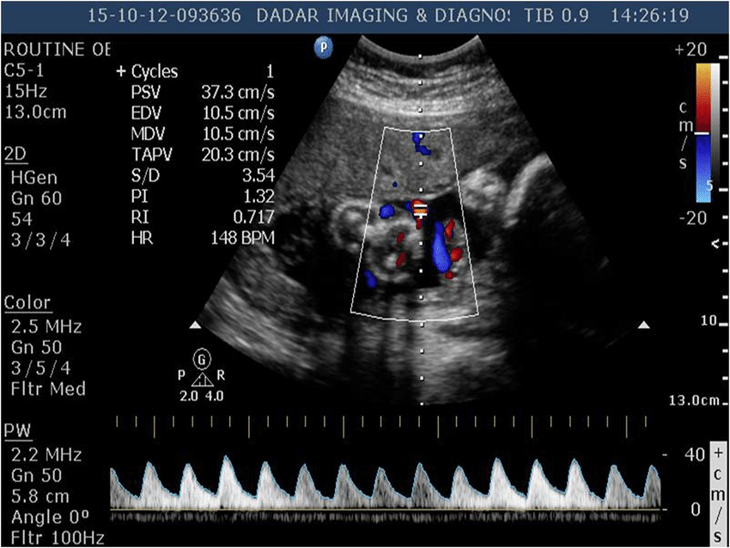
There are few dedicated clinical services (‘Rainbow Clinics’) that care for women in a subsequent pregnancy after stillbirth or neonatal death.
Models of multidisciplinary continuity of care combined with regular antenatal surveillance are associated with improved clinical outcomes, particularly a reduction in preterm birth and improved patient experience.
women with a history of stillbirth should have ultrasound measurement of fetal biometry.
Care in pregnancies after stillbirth
a subsequent pregnancy following stillbirth or neonatal death and that most parents did
not receive adequate emotional and psychological support.
Sixty-seven percent of parents received additional antenatal visits and 70% received
additional ultrasound scans; however, only 10% had access to a bereavement counsellor
Thus, care in the subsequent pregnancy not only.
needs to focus on the increased risk of adverse pregnancy outcome, but also on the
emotional and psychosocial effects on parents that persist into the subsequent pregnancy.

Slide 91
In particular, parents are at increased risk of intense anxiety, depression, fear, complex emotional responses
and refrain from forming bonds with the unborn baby as a coping mechanism.
Providing this level of emotional care requires specially trained staff, bereavement counsellors and time,
which can rarely be adequately provided in a busy ‘routine’ antenatal clinic.
There is no ‘ideal’ inter-pregnancy interval to reduce adverse outcome in a subsequent pregnancy;
in particular, the risk of stillbirth/SGA/pre-eclampsia in HICs is not altered by short or long inter-pregnancy intervals.
Many families embark on a pregnancy within 12 months of the stillbirth; indeed, 66% of parents who
participated in a large international survey reported conceiving their subsequent pregnancy within 1 year
of the stillbirth

Slide 92
The most commonly used intervention to reduce recurrent stillbirth from placental causes is aspirin:
150 mg once at night, ideally commenced before 16 weeks of gestation and continued until at least 36 weeks.
higher doses of aspirin (e.g. 150 mg rather than 75 mg) are more effective at preventing FGR and pre-eclampsia.
Although there are no data specifically on women whose previous pregnancy ended in stillbirth, this is thought to be beneficial for women whose stillbirth was associated with placental disease.
There is currently no high-grade evidence to support the use of low-molecular-weight heparin (LMWH) with the primary aim to prevent fetal complications in women with a history of stillbirth.
However, it should be used in women at high risk of maternal venous-thromboembolism.
Presently, it should be reserved for women with antiphospholipid antibody syndrome or CHI. chronic histiocytic intervillositis.
CHI is a rare placental lesion associated with poor obstetric outcome and has a high risk of recurrence in subsequent pregnancies (80%).
the number of live births increased in the treatment group from 32% to 67% with quadruple therapy of aspirin, LMWH, prednisolone and hydroxychloroquine and resulted in better pregnancy outcomes than aspirin alone.

Slide 93
Timing of birth Increasing evidence suggests the optimal time for delivery for the general obstetric population is at 39 weeks of gestation because after this point the risk of neonatal death does not fall, but the risk of stillbirth increases.
(IOL) ‘at term’ would reduce perinatal mortality by 70%.
additional emotional care is required in many women who have previously suffered
stillbirth and induced delivery from 38 weeks of gestation may be indicated.

Slide 94
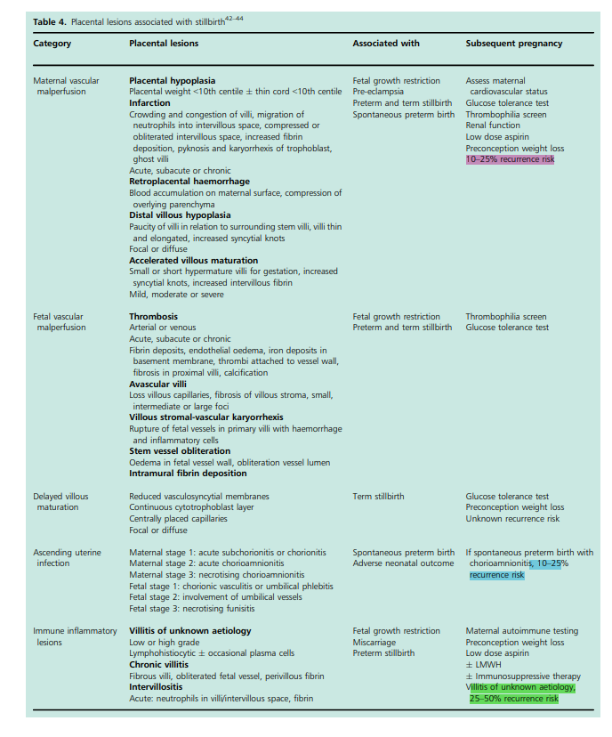

Slide 96
SBA 25
In relation to investigation of a stillbirth.which of the following is false ?
A) histopathological examination of the placenta by a pathologist provides useful information in at least 50% of cases
B) cytogenetic analysis is the most useful investigation to identify a cause of stillbirth.
C) histopathological examination of the placenta by a perinatal pathologist reduces the reporting of ‘unexplained’ stillbirth.

Slide 97
C) histopathological examination of the placenta by a perinatal pathologist reduces the reporting of ‘unexplained’ stillbirth.

Slide 98
SBA26
When a mother has a history of stillbirth in the previous pregnancy,
Which of the following option is incorrect ?
A) the likelihood of preterm birth is reduced in a subsequent pregnancy.
B) the likelihood of placental abruption is increased in a subsequent pregnancy.
C) the recurrence risk is highest when cause of the index stillbirth was of placental origin.

Slide 99
A) the likelihood of preterm birth is reduced in a subsequent pregnancy.

Slide 100
SBA 27
When caring for patients in a subsequent pregnancy after stillbirth,
Which of the following option is incorrect ?
A) women and their families are at increased risk of intense anxiety, depression, and complex emotional responses that persist into the subsequent pregnancy.
B) most families embark on a subsequent pregnancy within 12 months of the stillbirth.
C) women who have a history of stillbirth are less likely to stop smoking than women who have had a live birth.
D) aspirin commenced before 16 weeks’ gestation has been shown to significantly reduce the risk of stillbirth in high-risk women.
E) guidelines exist to standardise the care provided across the UK to women who have experienced a stillbirth.

Slide 101
C) women who have a history of stillbirth are less likely to stop smoking than women who have had a live birth.

Slide 102
SBA 28
The risk of stillbirth recurrence in a subsequent pregnancy can be reduced,
Which of the following option is incorrect ?
A) with the use of serial ultrasound scan measurements of fetal biometry and uterine and umbilical artery Doppler waveforms.
B) With regard to establishing the cause of stillbirth, using the relevant condition at death (ReCoDe) system is associated with the lowest unexplained rate.
C) a mother has a history of stillbirth in the previous pregnancy,the likelihood of complications is significantly influenced by the time interval between the two pregnancies.

Slide 103
C) a mother has a history of stillbirth in the previous pregnancy,the likelihood of complications is significantly influenced by the time interval between the two pregnancies.

Slide 104
You will fail only when you stop trying

